Slide 1

Siket Digitals
Modern websites for growing businesses.
Company profile · Addis Ababa · siketdigitals@gmail.com

Slide 2
WHO WE ARE
A small web studio in Addis Ababa that builds the site your business is judged by.
Siket Digitals designs and builds modern, responsive websites and web apps for businesses and organizations.
We are a team of three: two frontend developers and designers, and a backend developer. You talk to the people who do the work, not to an account manager.
Our aim is simple. Give your business a clear, professional presence online that works properly on a phone and makes it easy for people to reach you.
Local
Based in Addis Ababa. We meet in person or online, in your time zone.
Small on purpose
Three people, one project at a time each. Nothing gets lost in handoffs.
Modern tools
Built with React and current web standards, so the site is fast and easy to grow.
Siket Digitals · Addis Ababa · Est. 2026
2 / 9

Slide 3
WHY A WEBSITE
Your website is the first meeting. Most customers have it before they call you.
Trust
People look you up before they decide. A clear, current site tells them you are real, serious, and still in business.
Reach
A site works while you sleep. New customers in other neighbourhoods, cities, or countries can find and understand you.
Action
A good site does more than describe. It gives people one obvious way to call, message, or book, and sends that to your inbox.
Siket Digitals · Addis Ababa · Est. 2026
3 / 9

Slide 4
WHAT WE BUILD
Three kinds of work. Pick the one that fits where you are.
Marketing website
For a business that needs to be found and understood.
A site that explains what you do clearly and gives people an obvious way to get in touch. Home, services, about, contact, and whatever else your business needs.
Web app
For a business whose product lives in the browser.
Software people log into and use: dashboards, booking, ordering, internal tools. This can include AI that recommends things to each visitor.
Redesign
For a business whose site has fallen behind.
You keep your name and your content. We rebuild the site so it feels current, reads clearly, and works properly on a phone.
Siket Digitals · Addis Ababa · Est. 2026
4 / 9

Slide 5
WHAT YOU GET
Every site we hand over comes with these, without asking.
Works on every phone
Designed for the phone first, then the laptop. Most of your visitors are on a phone.
Loads fast
Light pages, compressed images, and no bloat. Fast sites keep visitors and rank better on Google.
Easy to contact you
A contact form that lands in your email, plus your phone and location where people expect them.
Your own domain
We set up your domain, hosting, and a secure https address, and put everything in your name.
Found on Google
Proper page titles, descriptions, and structure so search engines can read and list the site.
Handed over ready
You get the live site, the login details, and a short walkthrough. We stay reachable after launch.
Siket Digitals · Addis Ababa · Est. 2026
5 / 9

Slide 6
HOW A PROJECT GOES
Four steps, from the first conversation to launch.
01
02
03
04
WHAT WE NEED FROM YOU
Your logo, if you have one
A few lines about the business and each service
Photos, or permission for us to source them
Phone, email, and address to show
One person who can say yes
Do not have all of it? Start anyway. We help with the writing.
Talk
We learn the business, who it serves, and what the site has to do.
Shape
We plan the pages and how the site should look and work. You approve before we build.
Build
We design and develop it, and you see the work as it comes together.
Launch
We put it online on your domain and hand it over ready to use.
Siket Digitals · Addis Ababa · Est. 2026
6 / 9

Slide 7
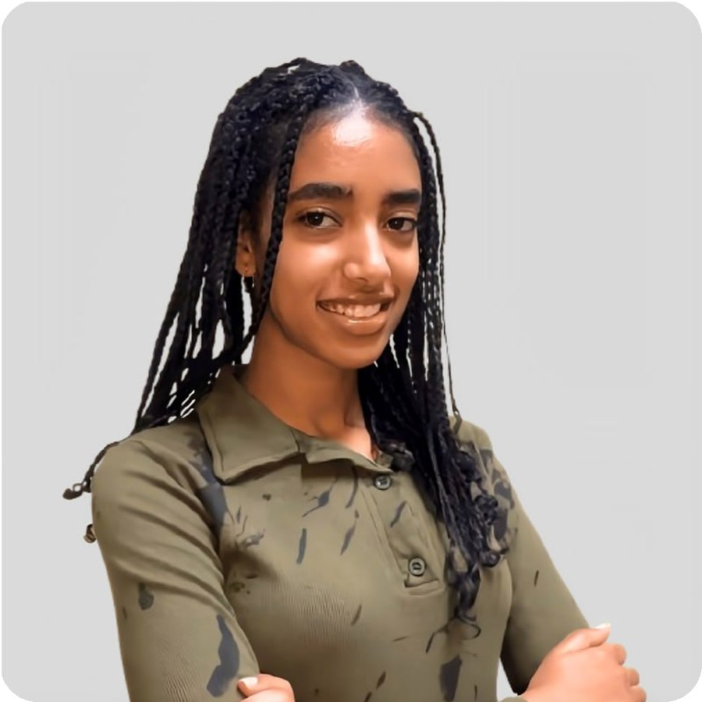
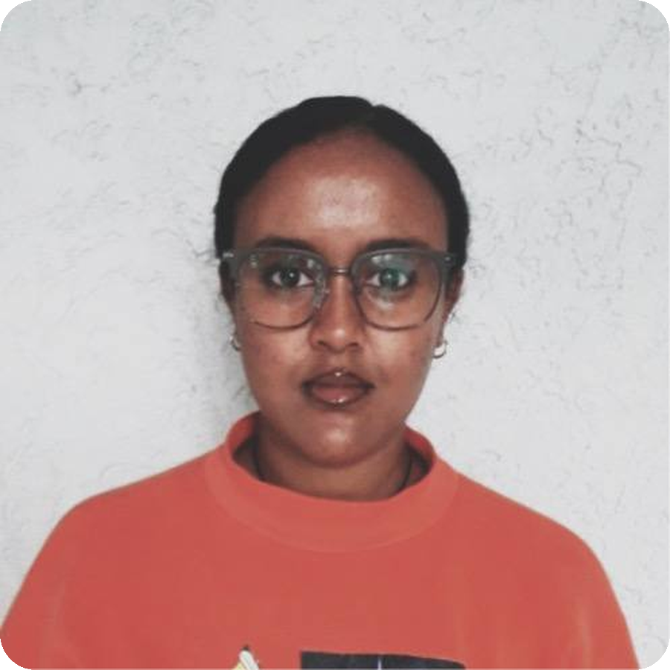
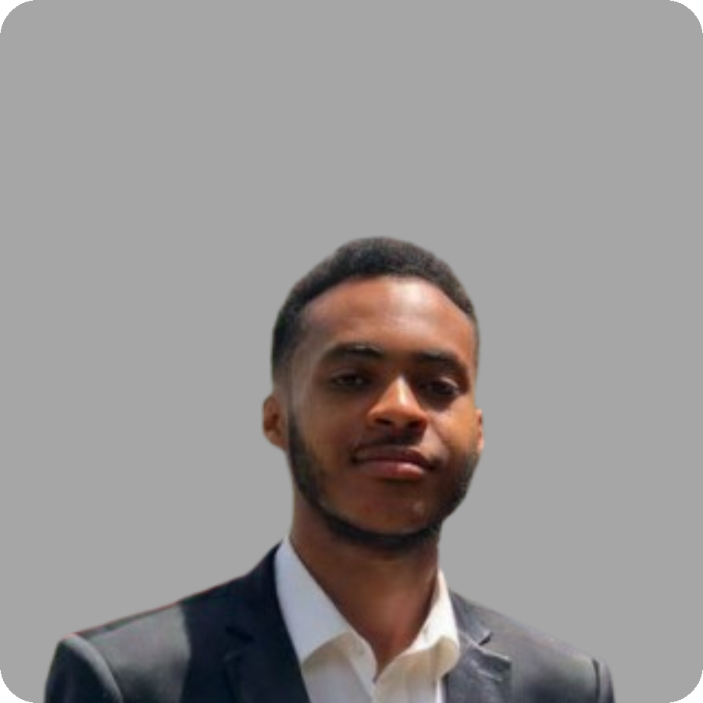
THE TEAM
The people who will design, build, and keep it fast.
Mihret Daniel
Frontend developer
Uses React to build good-looking websites, and adds AI so a site can recommend things to each visitor.
Ribka Muluye
Frontend developer and web designer
Makes modern, aesthetic websites from the first layout to the finished interface, shaped around each client.
Sofoniyas Tekalegn
Backend developer
Creates well-structured databases, secure APIs, and the logic that keeps data safe and pages fast.
Siket Digitals · Addis Ababa · Est. 2026
7 / 9

Slide 8
WHY WORK WITH US
What you can hold us to.
You talk to the builders
No layers. The person you brief is the person who designs and codes.
You see it as it grows
Work in progress is shared on a live link, so there are no surprises at the end.
Clear scope, clear price
We agree what the site includes before we start, and we say so if something changes it.
Built to be changed
Clean, modern code. Adding a page or a service later is simple, by us or by anyone.
Honest timelines
A marketing site usually takes two to four weeks once we have your content. We tell you if it will take longer.
Here after launch
Questions, small edits, and fixes do not stop at handover. We are in Addis Ababa and reachable.
Siket Digitals · Addis Ababa · Est. 2026
8 / 9

Slide 9
Let's start with a conversation
Tell us about the business and what the site has to do. We reply within a working day with questions, a rough scope, and a time to talk.
EMAIL
siketdigitals@gmail.com
PHONE
0937 591 141
LINKEDIN
linkedin.com/company/siket-digital
CITY
Addis Ababa, Ethiopia
Thank you for reading. We would be glad to build with you.

